Slide 1
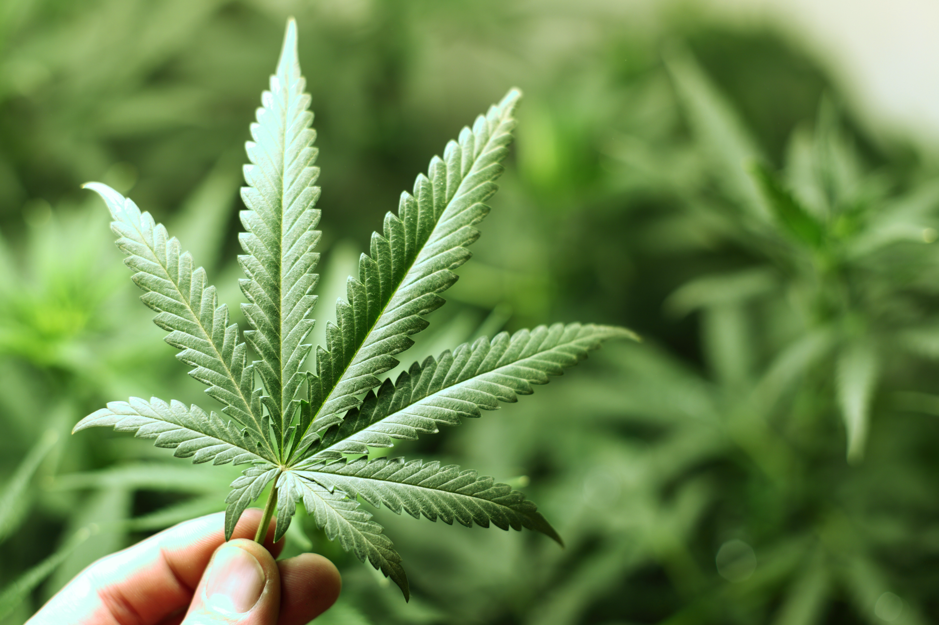

Slide 2
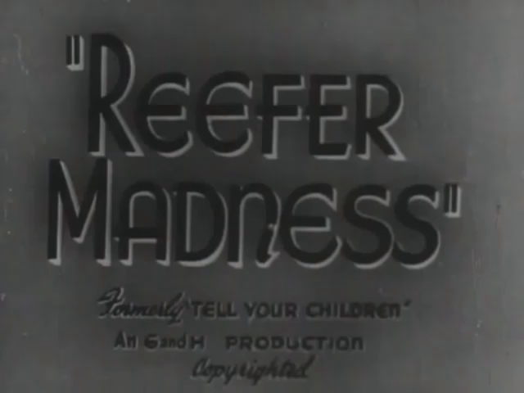

Slide 3
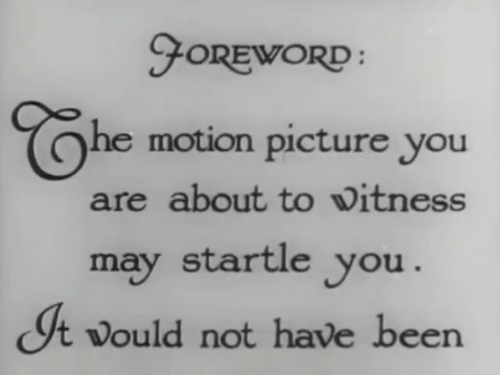

Slide 4
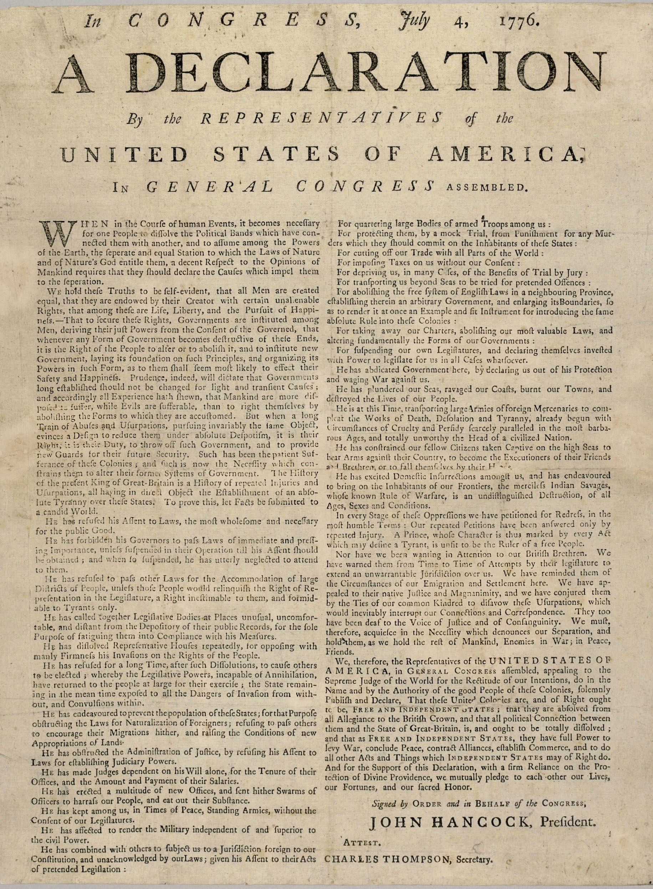

“We hold these truths to be self-evident, that all men are created equal, that they are endowed by their Creator with certain unalienable Rights, that among these are Life, Liberty and the pursuit of Happiness.
-- That to secure these rights, Governments are instituted among Men, deriving their just powers from the consent of the governed…”

Slide 5
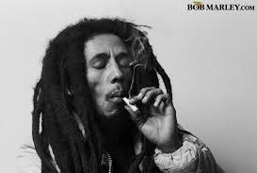

Slide 6
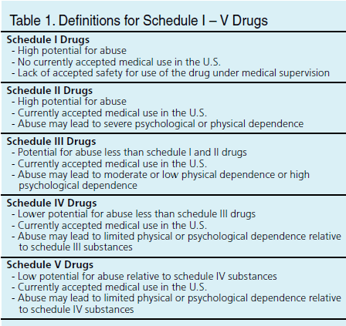

Slide 7
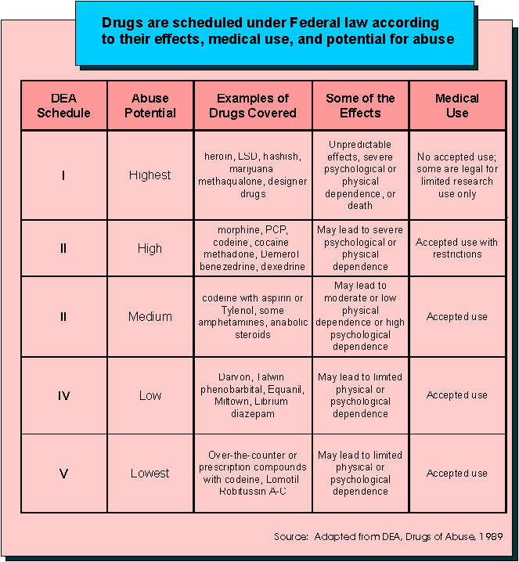

Slide 8
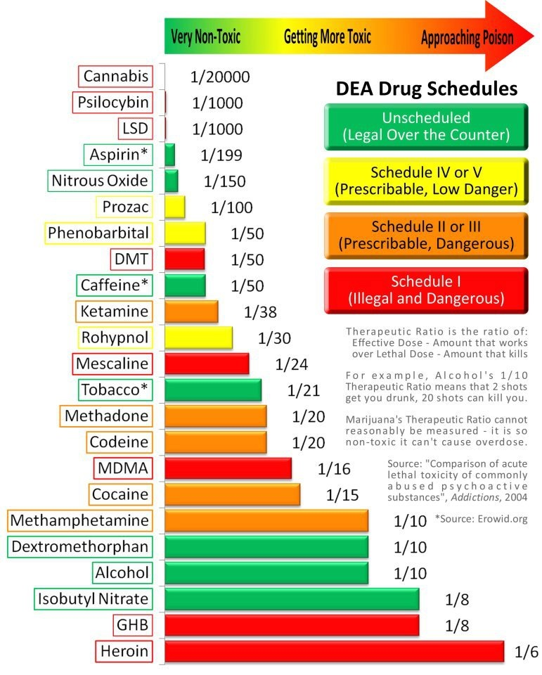

Slide 9

Under federal law, it is illegal to possess, use, buy, sell, or cultivate marijuana, since the Controlled Substance Act of 1970 classifies marijuana as a Schedule I drug, claiming it has a high potential for abuse and has no acceptable medical use. Some states and local governments have established laws attempting to decriminalize cannabis, which has reduced the number of "simple possession" offenders sent to jail, since federal enforcement agents rarely target individuals directly for such relatively minor offenses.
Other state and local governments ask law enforcement agencies to limit enforcement of drug laws with respect to cannabis, however under the Supremacy Clause of the United States Constitution, federal law preempts conflicting state and local laws.

Slide 10
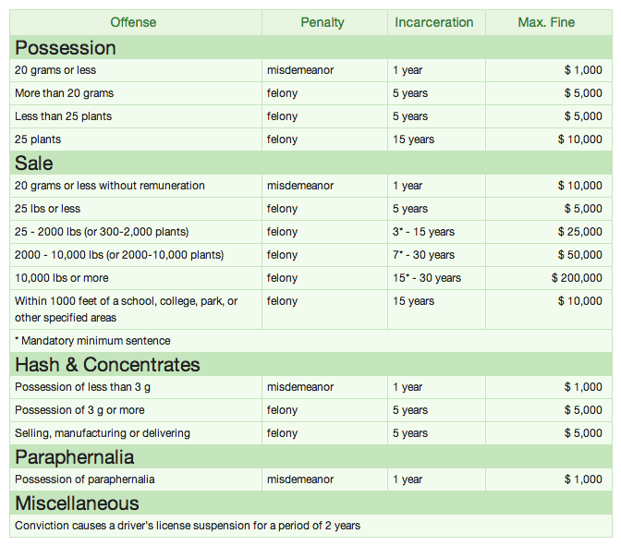
Florida Law

Slide 11

According to the FBI, there were a total of 1.5 million drug arrests made nationwide in 2011, and out of those arrests, about 750,000 were for marijuana (just under half, 49.5 percent) -- that's one marijuana arrest every 42 seconds and one drug arrest every 21 seconds in the U.S.

Slide 12
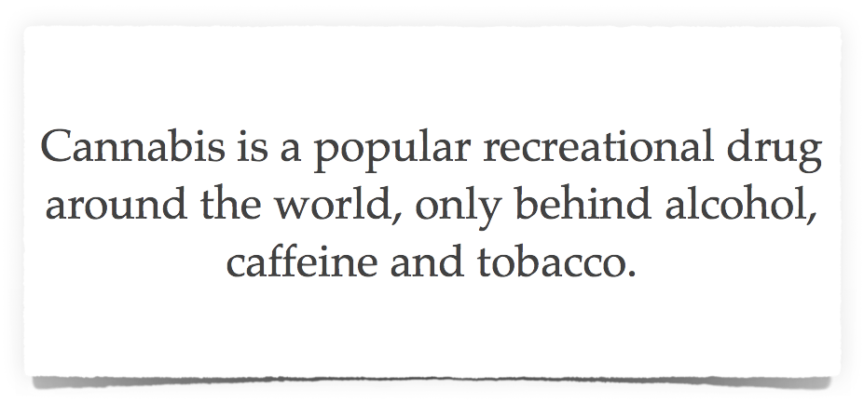

Slide 13

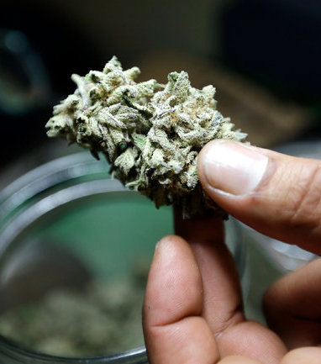
Blacks Are Singled Out for Marijuana Arrests, Federal Data Suggests
Black Americans were nearly four times as likely as whites to be arrested on charges of marijuana possession in 2010, even though the two groups used the drug at similar rates, according to new federal data.

Slide 14
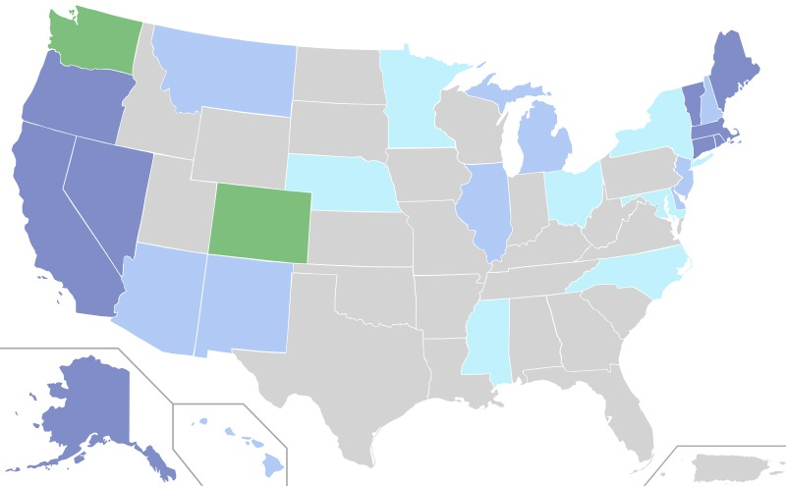
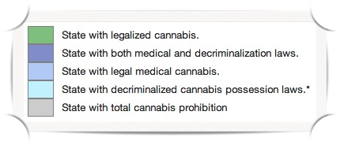
Map of the US showing US cannabis laws

Slide 15

In 1978 Robert Randall sued the federal government for arresting him for using cannabis to treat his glaucoma. The judge ruled Randall needed cannabis for medical purposes and required the Food & Drug Administration to set up a program to grow cannabis on a farm at the University of Mississippi and to distribute 300 cannabis cigarettes a month to Randall. In 1992 George H.W. Bush discontinued the program after Randall tried to make AIDS patients eligible for the program. Thirteen people were already enrolled and were allowed to continue receiving cannabis cigarettes; today the government still ships cannabis cigarettes to seven people

Slide 16
Cannabinoids Identified in Marijuana
 | Cannabinoid Group | Abbreviation | Known Variants
1 | 9-Tetrahydrocannabinol | 9-THC | 9
2 | 8-Tetrahydrocannabinol | 8-THC | 2
3 | Cannabichromene | CBC | 5
4 | Cannabicyclol | CBL | 3
5 | Cannabidiol | CBD | 7
6 | Cannabielsoin | CBE | 5
7 | Cannabigerol | CBG | 6
8 | Cannabinidiol | CBND | 2
9 | Cannabinol | CBN | 7
10 | Cannabitriol | CBT | 9
11 | Miscellaneous types |  | 11
 | TOTAL |  | 66

Slide 17

Charlotte's Web is a strain of medical marijuana processed into a marijuana extract that is high in cannabidiol (CBD) content, called Realm Oil and Alepsia. It does not induce the psychoactive “high” typically associated with recreational marijuana use.
Charlotte's Web is named after Charlotte Figi, whose parents and physicians found that she experienced a radical reduction of her epileptic seizures after her first dose of medical marijuana at five years of age, and whose use of the strain was featured in the 2013 CNN documentary "Weed." Media coverage increased demand for Realm Oil and similar products high in CBD, which has been used to treat cancer and epilepsy in toddlers and children. While high profile and anecdotal reports have sparked interest in treatment with cannabinoids.

Slide 18
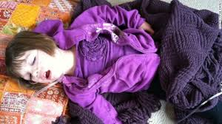

Slide 19


Slide 20
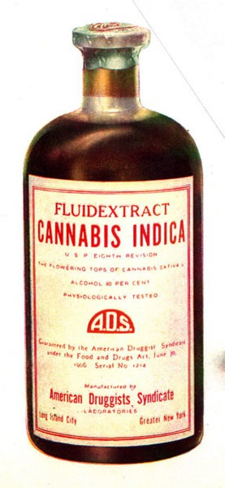

Slide 21
